Slide 1


PROJECT
STREET
FIGHTER
Revolutionizing the game with Java programming

Slide 2

Introduction
Step into the electrifying world of Street Fighter, a dynamic 2-D game brought to life through the power of Java. This project blends the magic of Java's core functionalities with the thrill of action-packed gameplay, offering an engaging platform for beginners to master OOP, GUI design, and game development. Get ready to unleash your inner programmer and fighter!

Slide 3
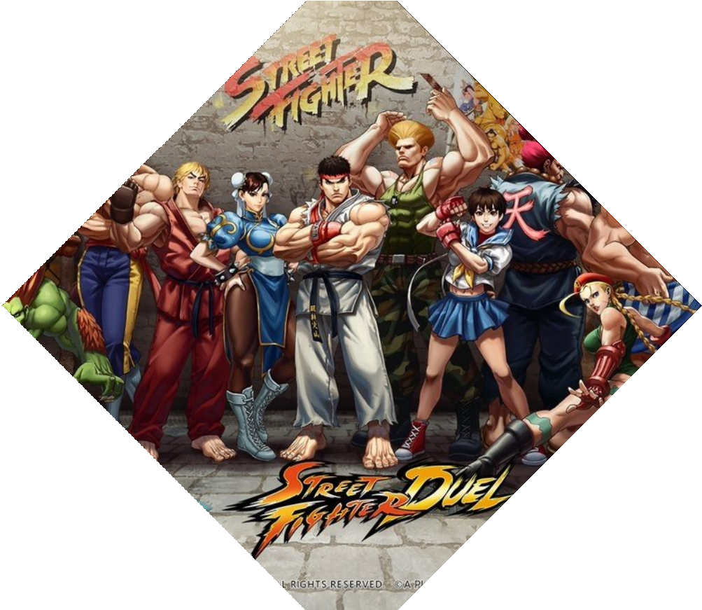
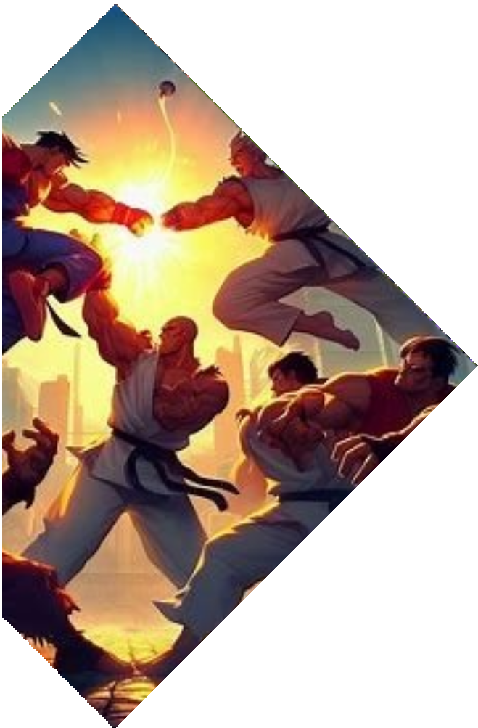

Understanding: Street Fighter Game
Before we delve into the Java programming techniques, let's have a brief overview of Street Fighter. It is a legendary ﬁghting game franchise known for its intense battles and diverse characters. With its rich history and dedicated fan base, Street Fighter provides the perfect platform for us to showcase the power of Java programming in revolutionizing the game.

Slide 4

The Power of Java Programming
Java programming language offers a wide range of powerful features that can be leveraged to enhance Street Fighter. From advanced graphics rendering to efﬁcient game logic implementation, Java provides the foundation for creating a cutting-edge gaming experience. With its platform independence and extensive libraries, Java opens up endless possibilities for revolutionizing Street Fighter.

Slide 5


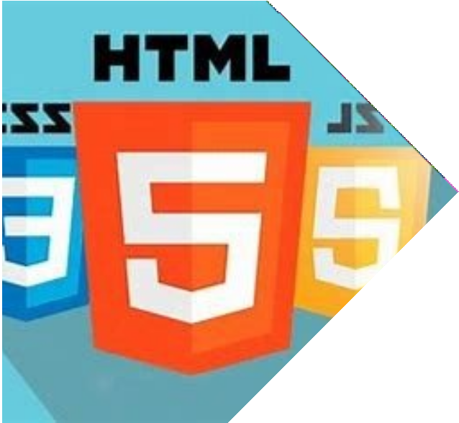

Other Text Stacks are
Apart from Java, alternative tech stacks for creating a Street Fighter game include C++ with popular game development libraries like Unreal Engine, Unity using C#, or HTML5 with JavaScript and WebGL for browser-based games. These options offer diverse tools and platforms to bring the iconic Street Fighter experience to life.

Slide 6

Why choose JAVA ?
Java programming empowers us to create custom characters in Street Fighter. With Java's object-oriented approach, we can design unique ﬁghters with distinct abilities and special moves. By leveraging Java's inheritance and polymorphism, we can easily extend the existing character roster, providing players with a diverse and customizable gameplay experience.

Slide 7
Features Used:
JPanel
Timer
KeyListener
JFrame
BufferedImage
Graphic Pen
Getter and Setter Methods
Game Constants
Sprite

Slide 8

JAVA Specific Features
Object-Oriented Programming (OOP)
AWT (Abstract Window Toolkit)
Swing
Inheritance and Polymorphism
Event Handling
Multithreading
Exception Handling
Collections Framework
Swing Components

Slide 9


Difficulties Faced

Slide 10
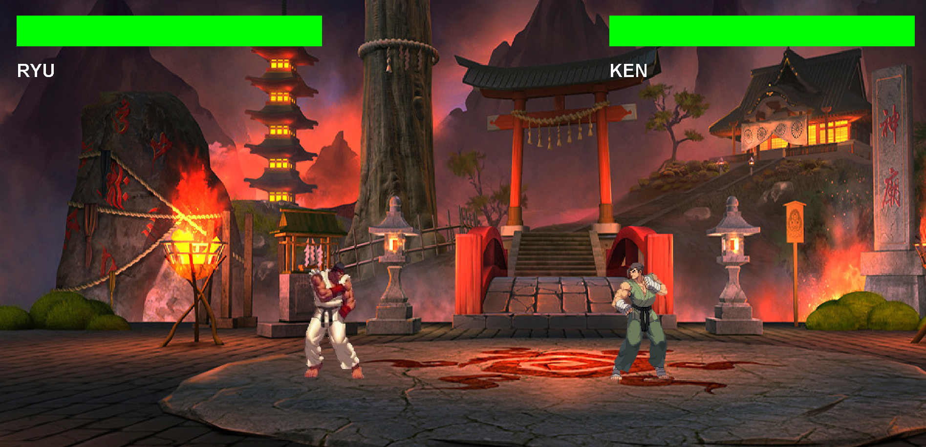
Real-Time game visual

Slide 11
Conclusion
In conclusion, Java programming offers an exciting opportunity to revolutionize Street Fighter. By harnessing the power of Java, we can enhance gameplay mechanics, create custom characters, and take the game to new heights of excitement and innovation. Embrace the cutting-edge approach of Java programming and unlock the full potential of Street Fighter.

Slide 12


Thanks!
Do you have any questions?
mittald77@gmail.com
https://github.com/DhruvMittal2001

